Slide 1


Analysis of Google Play Store Apps
ABIDEMI LAWAL
MICHAEL NYAKONU
DECEMBER 7TH, 2018

Slide 2
AGENDA
INTRODUCTION
DATA DESCRIPTION
QUESTIONS
ANALYSIS TASK 1
ANALYSIS TASK 2
ANALYSIS TASK 3
ANALYSIS TASK 4

Slide 3

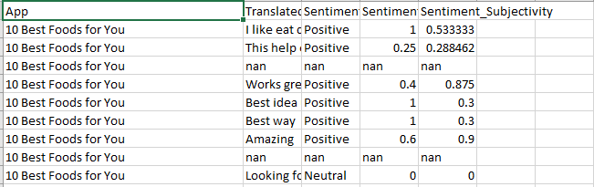
INTRODUCTION
The data consist of two files
File 1: This file consists of 100 ratings per every application in the play store. The fields in this file is
App|Translated_Review|Sentiment|Sentiment_Polarity|Sentiment_Subjectivity

Slide 4
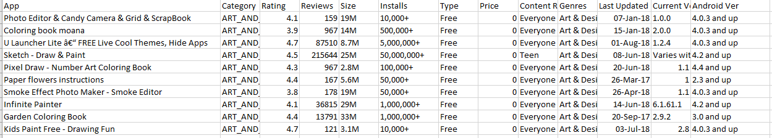
INTRODUCTION …
File 2: In this file data on the various applications details are stored. This file consists of detailed application information of the apps on Google Play Store. Fields include:
App| Category| Rating| Reviews| Size| Installs| Type| Price| Content Rating| Genre| Last Updated| Android Version

Slide 5
Data Used in The Analysis
 | File 1
App | This is the name of the applications that are in the google plays store(will mostly be used as our key in any join we perform throughout the analysis)
Sentiment | This represents how the users felt in regard to a certain application. It has to two values. Namely positive or negative
 | File 2
App | This is the name of the applications that are in the google plays store (will mostly be used as our key in any join we perform throughout the analysis)
Category | This field represents the application category. It states what kind of application has been placed on the app store e.g. Art & Design, Communication etc.
Rating | This is the application rating as it stands on google play at the time the data was collected from the google play store
Type | This contains data on whether an application is free or is a sold application.
Genre | This represent what kinds of genre the applications are designed to be.

Slide 6
QUESTIONS TO BE ANALYZED
Does the type of App affect the Sentiment of the users? Are the customers using free apps more satisfied than the customers using paid apps?
Does the genre of the App affect the sentiments of the user?
What are the Top 10 genres and Bottom 10 Genres regarding how many apps fall under each genre?
What are the top 10 categories and the bottom 10 categories in terms of ratings?

Slide 7

Analysis Task 1
Does the type of App affect the Sentiment of the users? Are the customers using free apps more satisfied than the customers using paid apps?

Slide 8
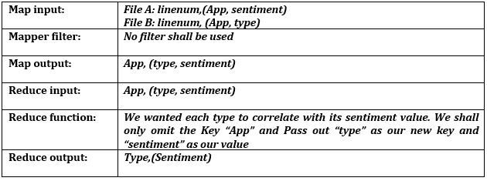
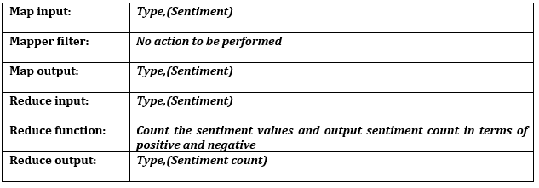
Analysis Task 1
Job 1
Job 2

Slide 9

Outputs

Slide 10
Charts

Slide 11
Analysis Task 2
Does the genre of the App affect the sentiments of the user?

Slide 12
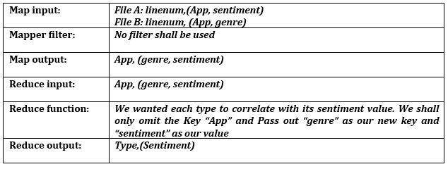
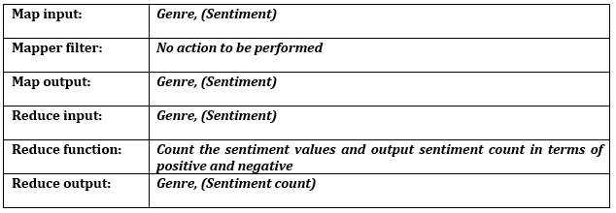
Analysis Task 2
Job 1
Job 2

Slide 13
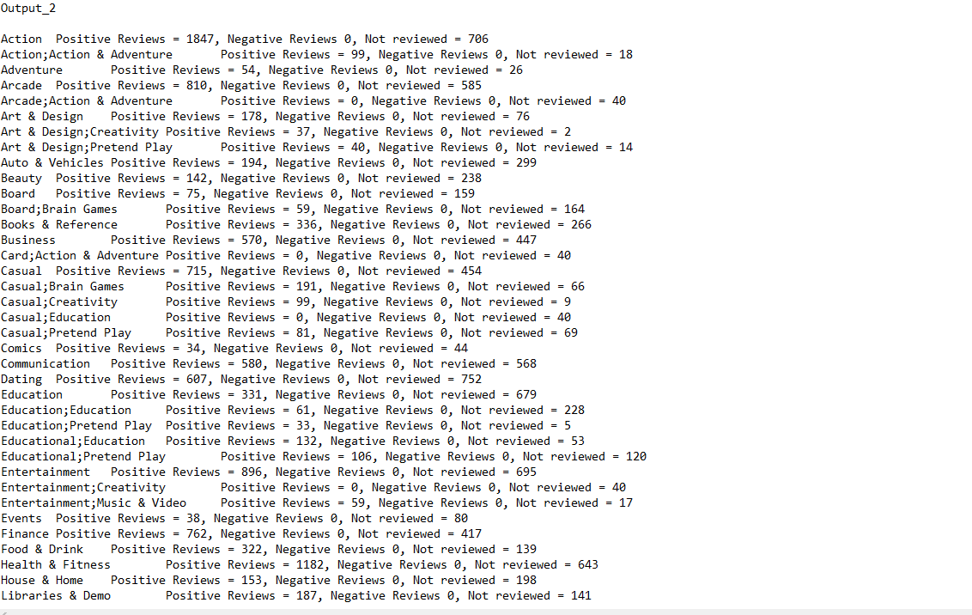
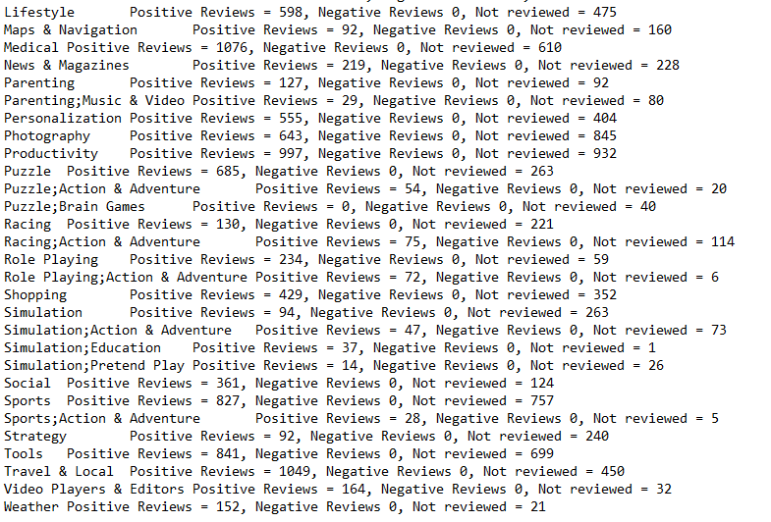
Outputs

Slide 14
Charts

Slide 15
Analysis Task 3
Find the Top 10 genres and Bottom 10 Genres regarding how many apps fall under each genre.

Slide 16
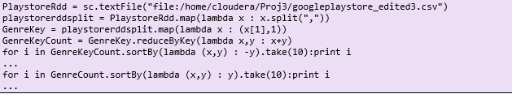
Analysis 3 (PySpark)

Slide 17
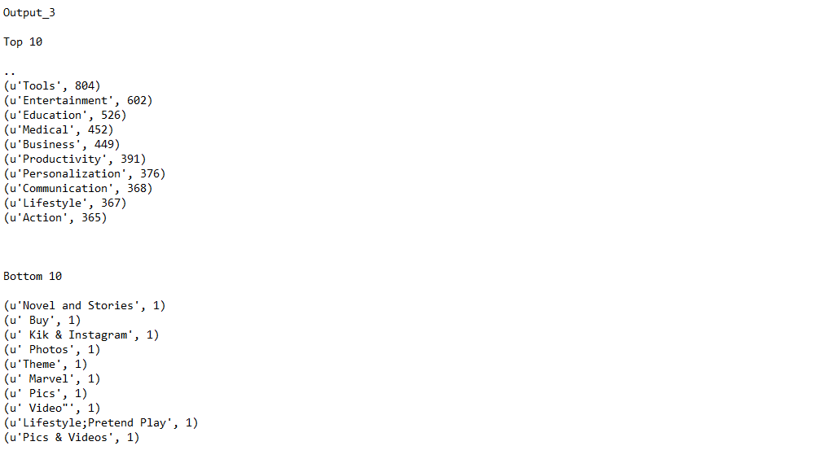
Screenshot of Outputs

Slide 18
Charts

Slide 19
Analysis Task 4
Find the top 10 categories and the bottom 10 categories in terms of ratings

Slide 20
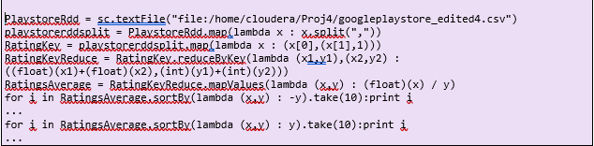
Analysis 4 (Pyspark)

Slide 21
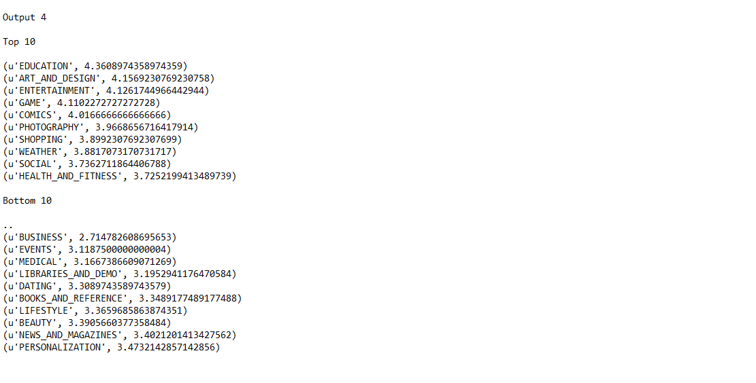
Screenshot of Outputs

Slide 22
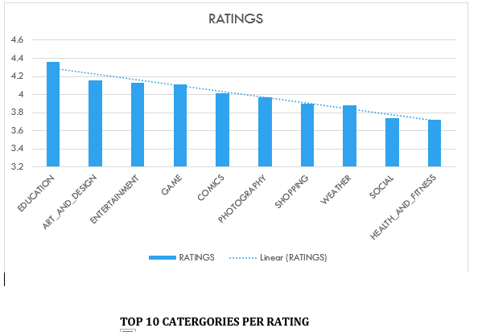
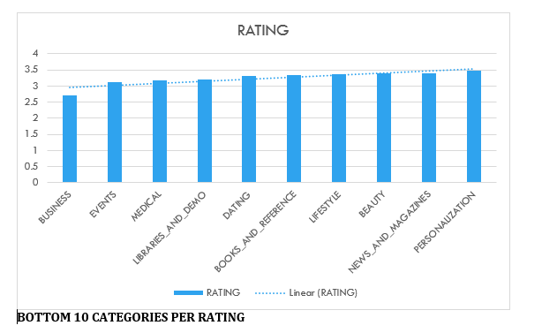
Charts

Slide 23

Questions?

Slide 24
THANK YOU

